Slide 1
Podcasting to extend your marketing reach
Dan Schlossberg and Christopher Patrick Lucas

Slide 2

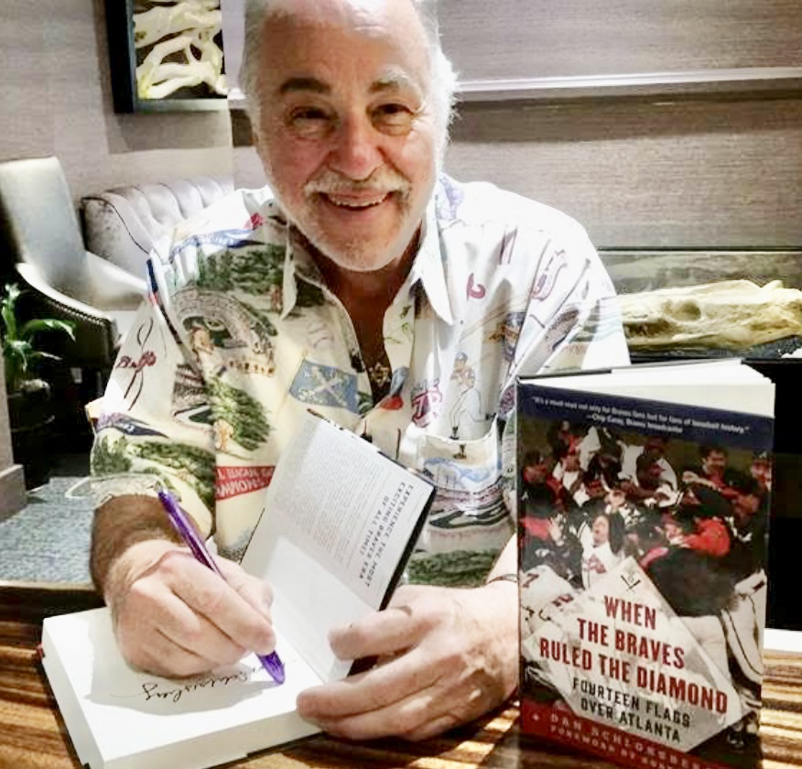

Dan schlossberg

Slide 3




Slide 4

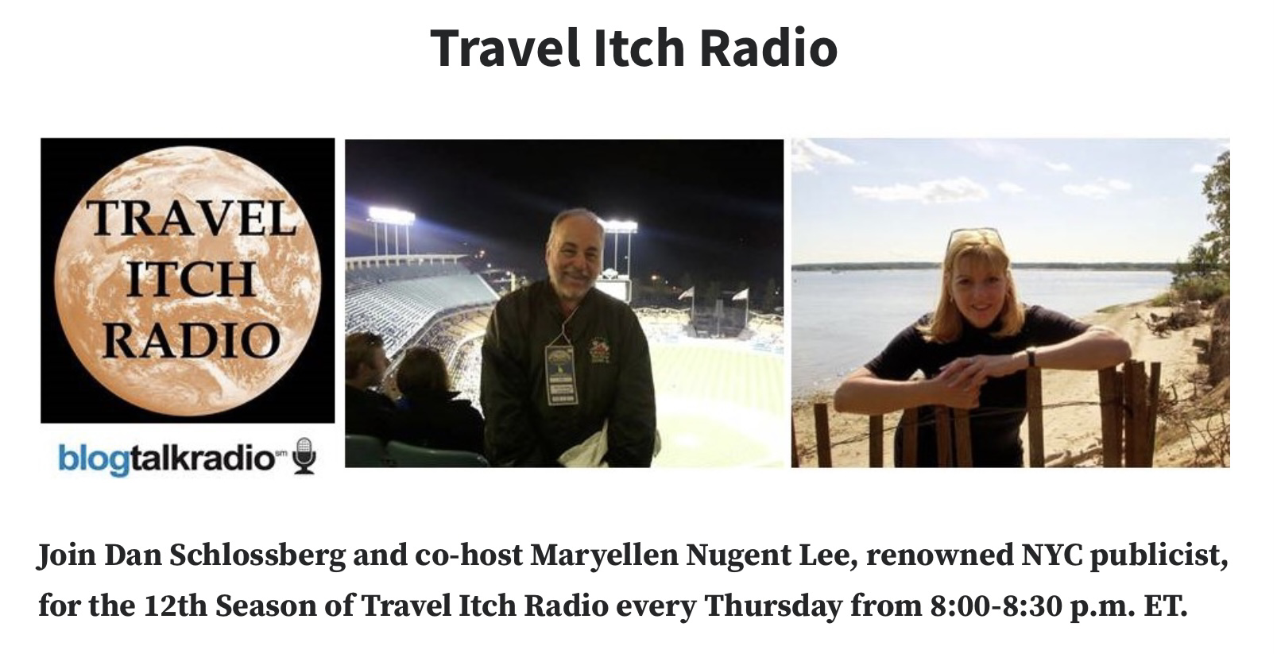
Braves Banter
7 years
Weekly episodes
Over 300 shows
Travel Itch Radio
13 years
Weekly episodes
Over 500 shows

Slide 5
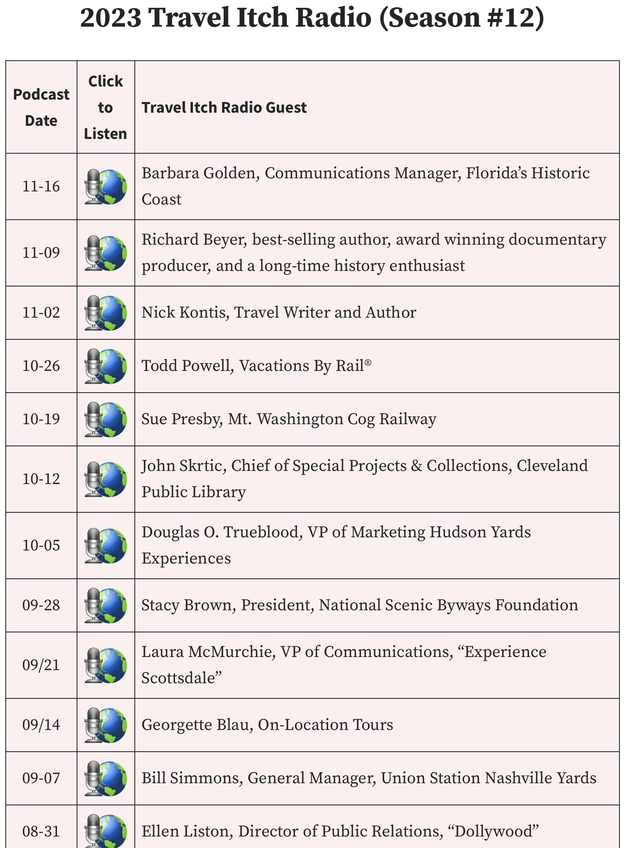
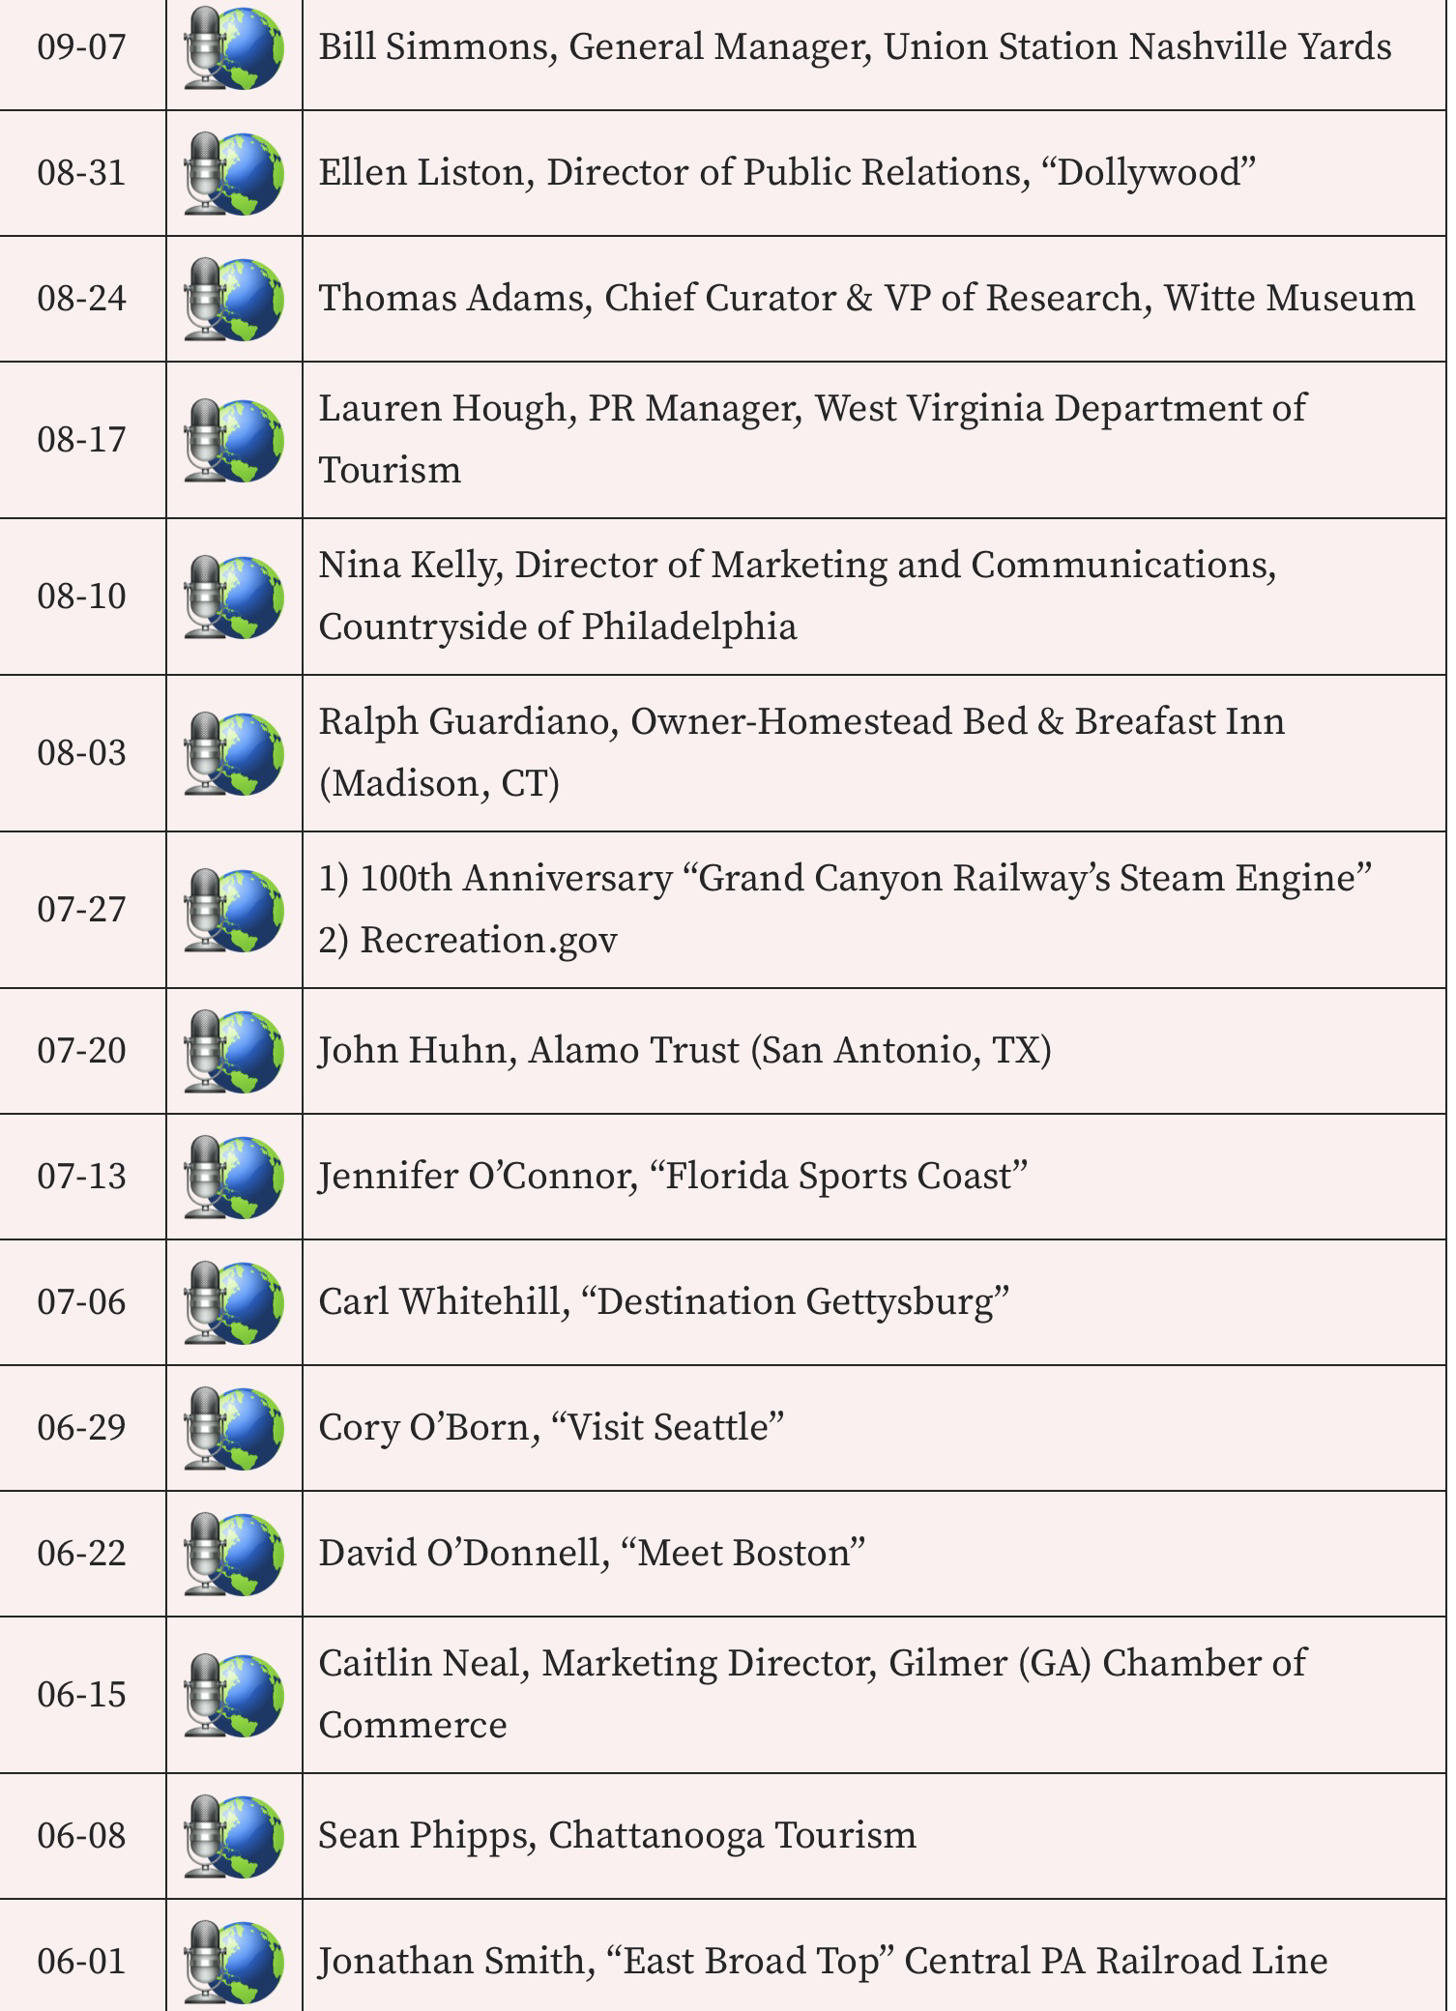

Slide 6
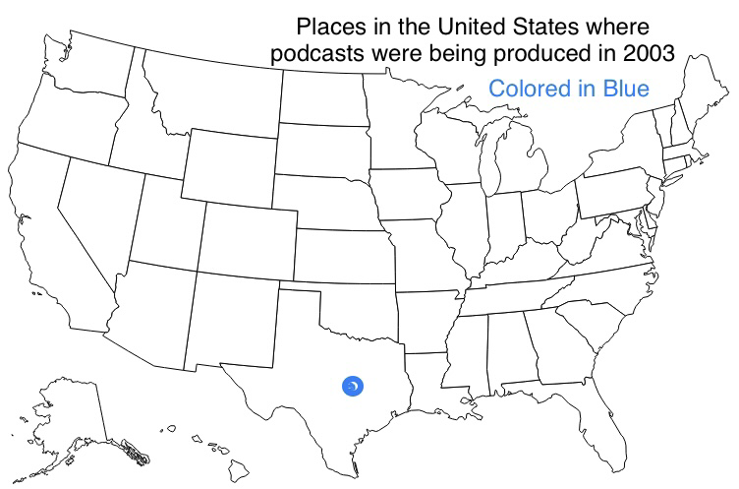

Slide 7
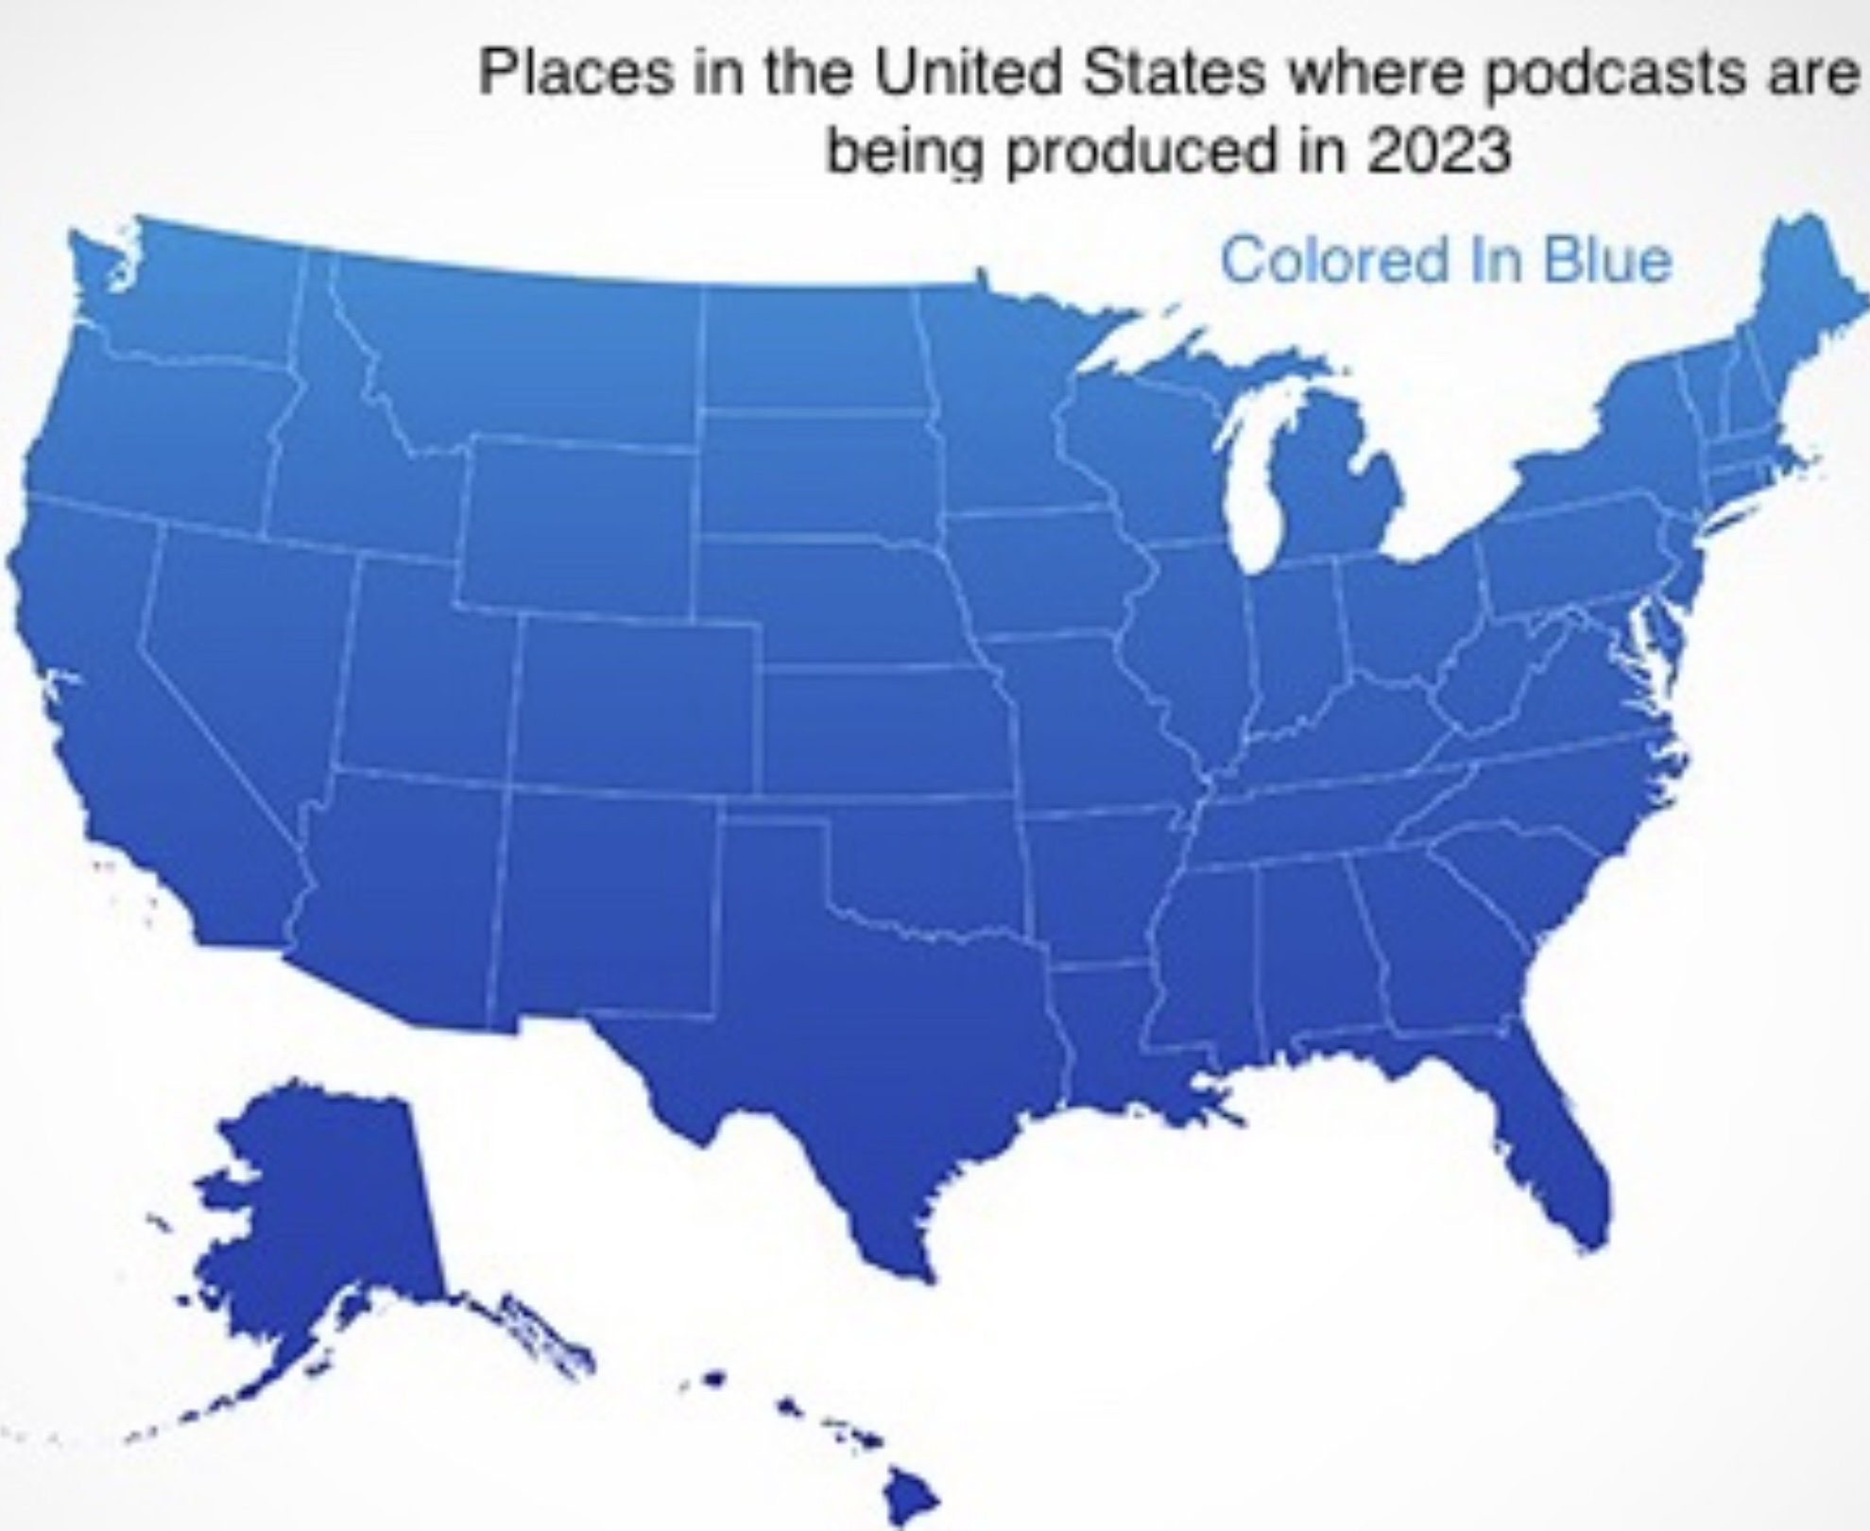

Slide 8

Adam curry
“the father of podcasting” first official podcast
“Daily source code” from Austin, texas
December, 2003 estimated audience size:
500 listeners

Slide 9
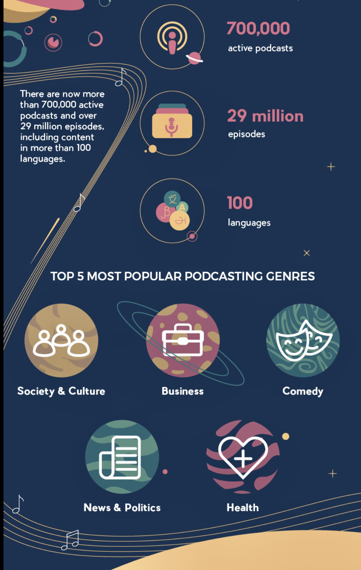
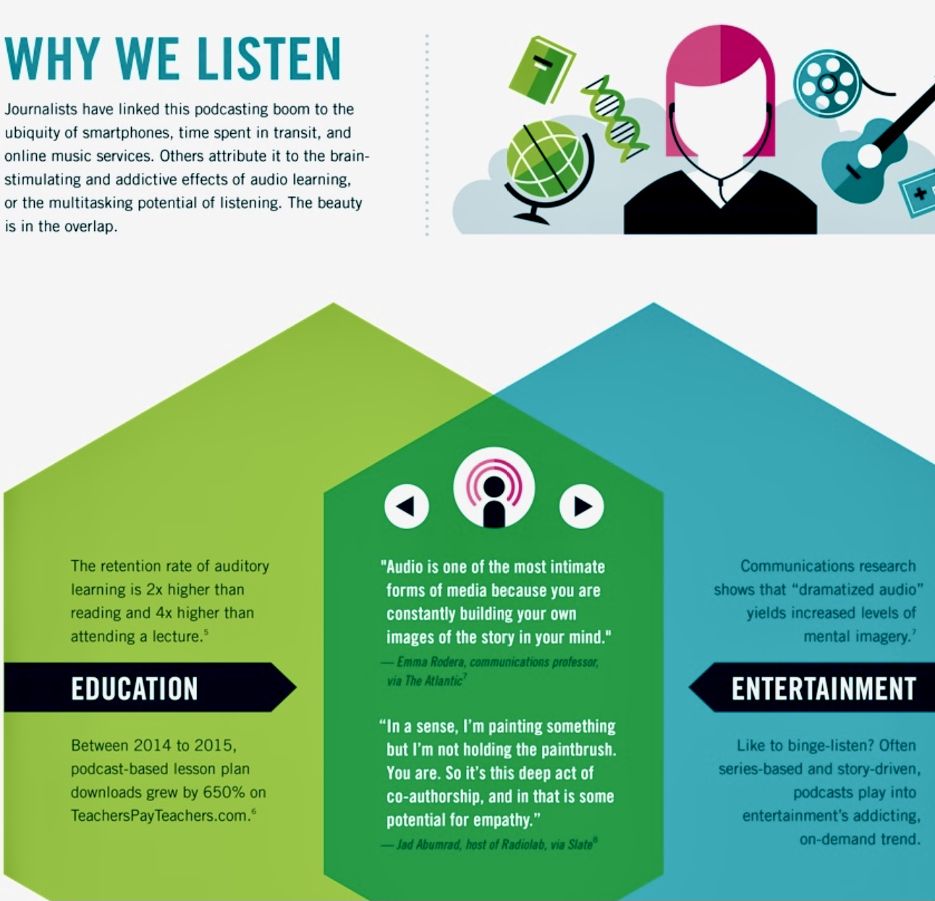

Slide 10
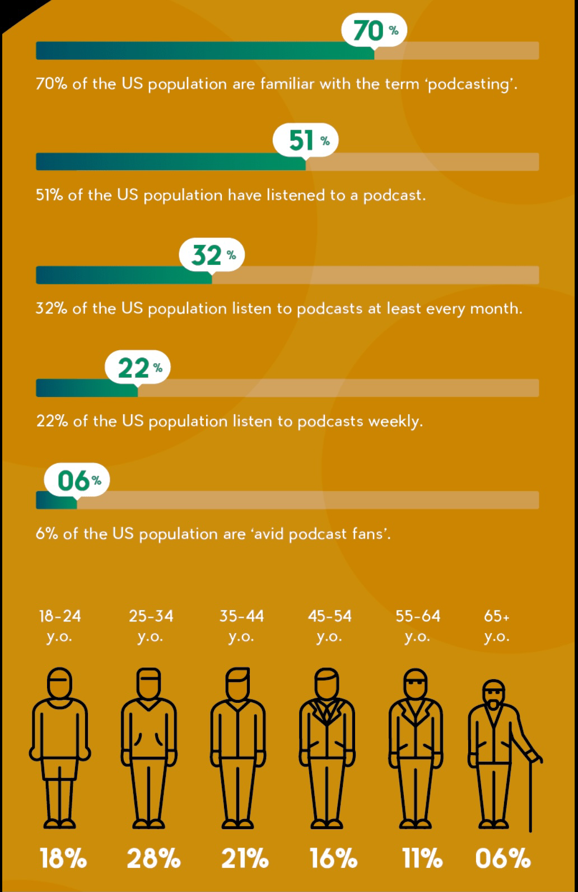
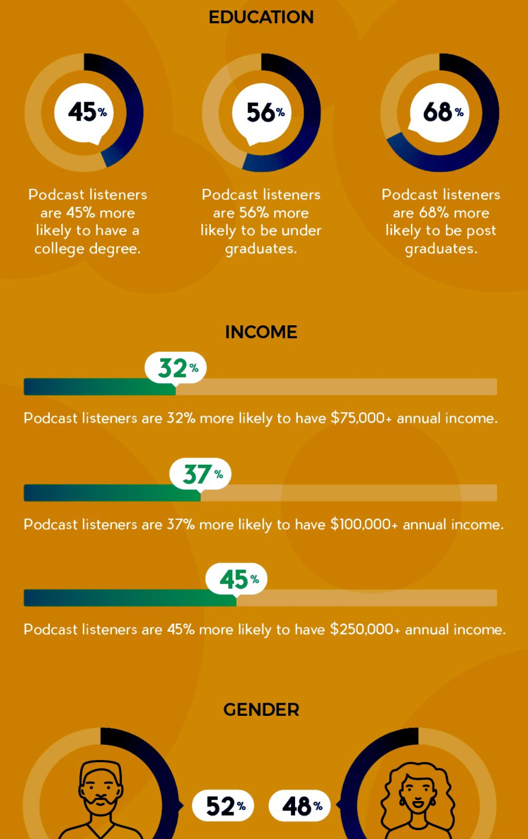

Slide 11
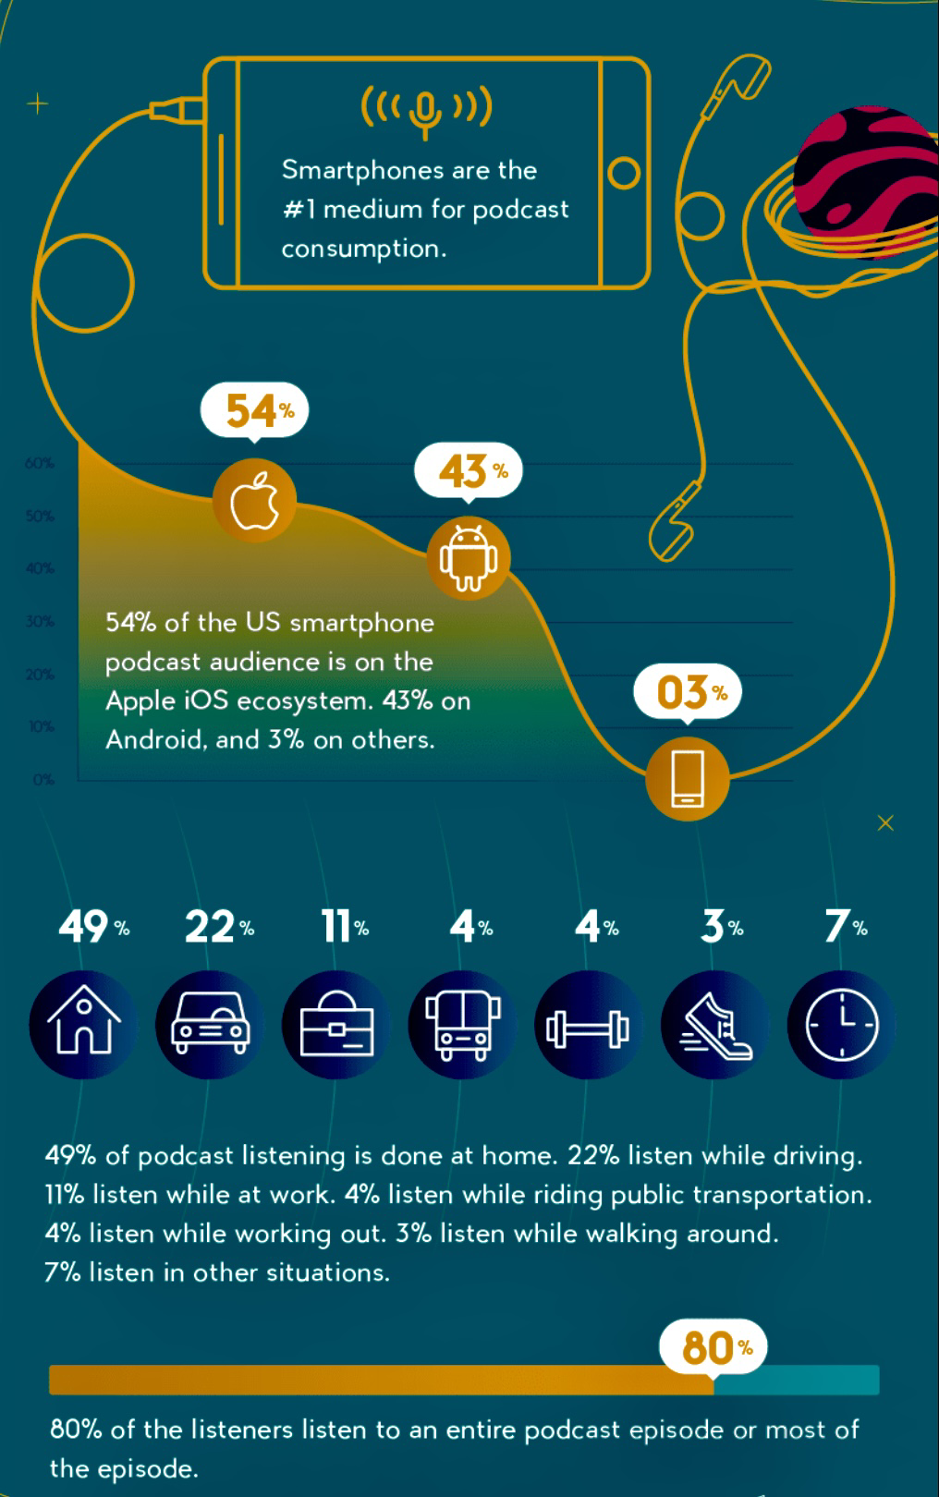
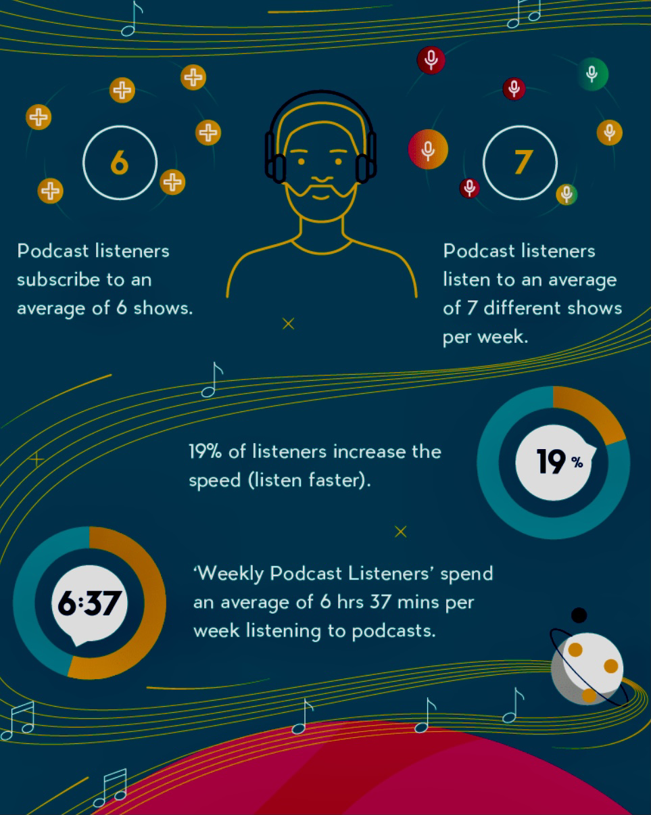

Slide 12
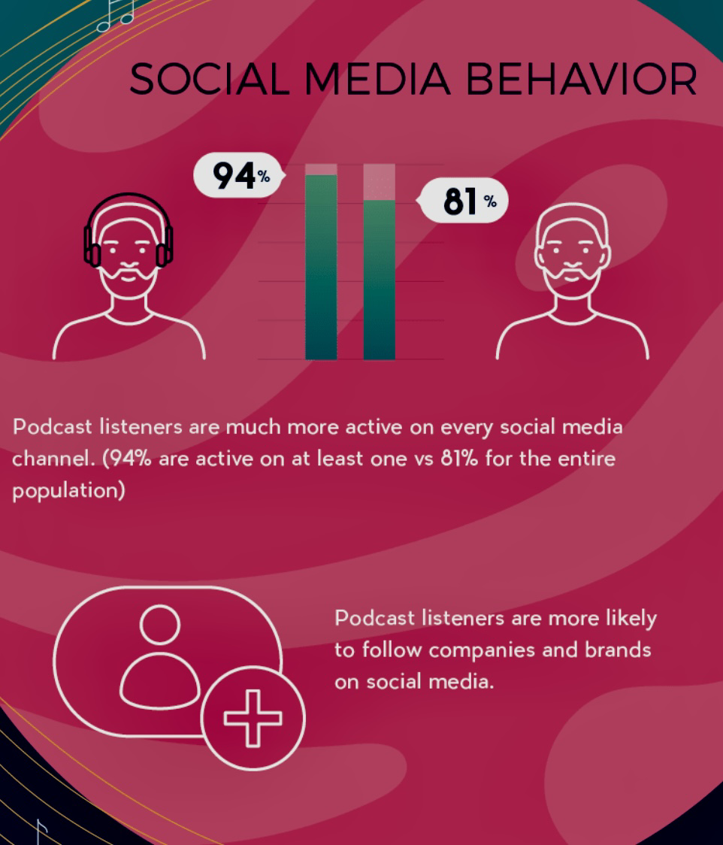
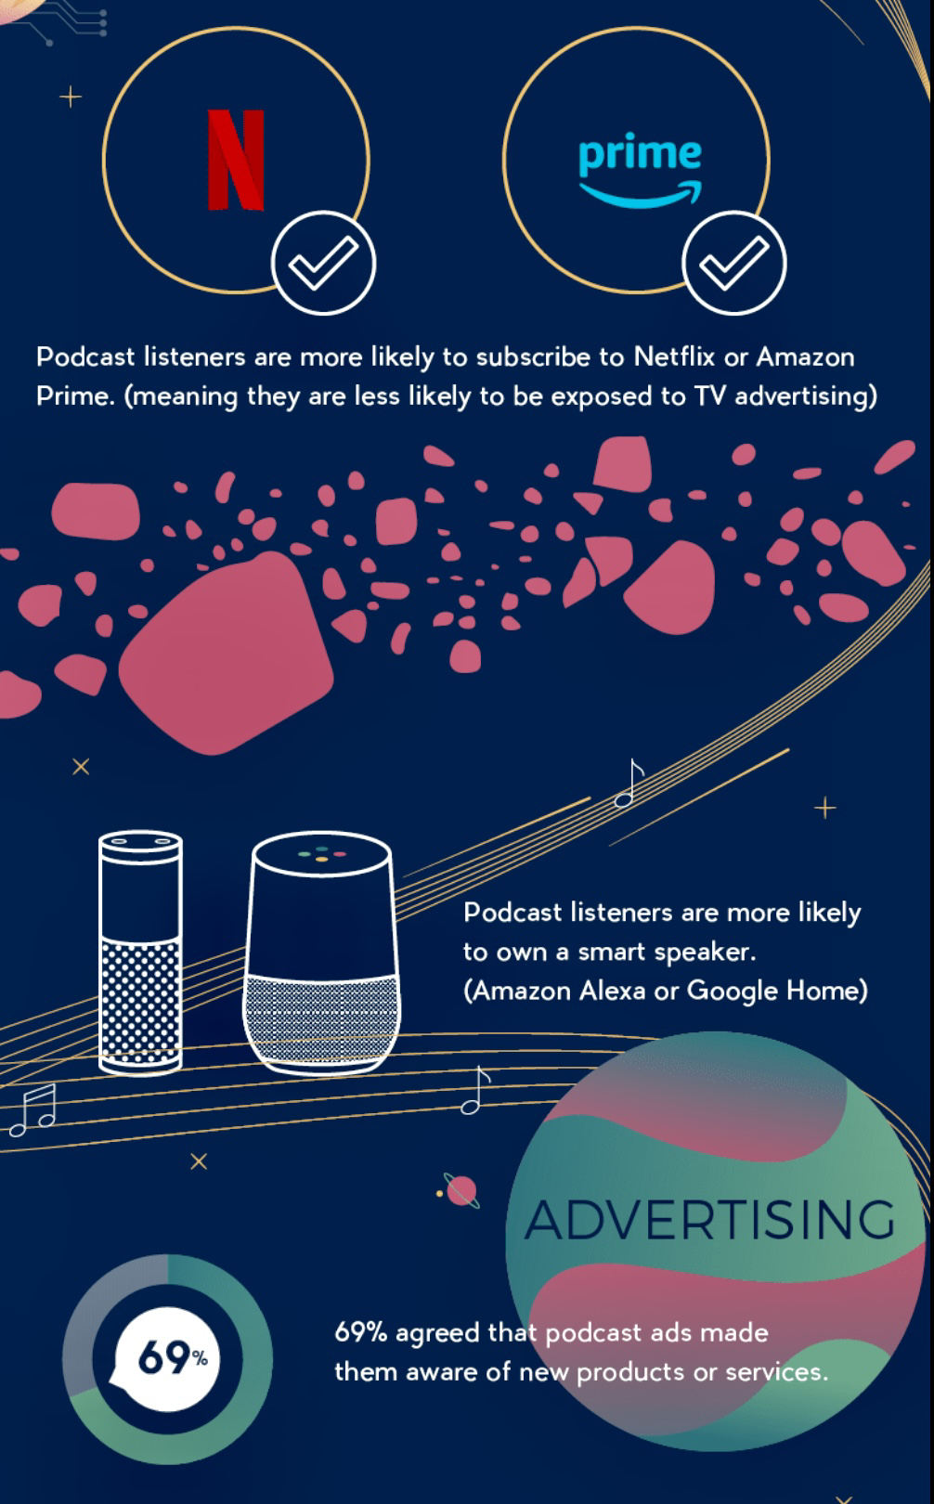

Slide 13
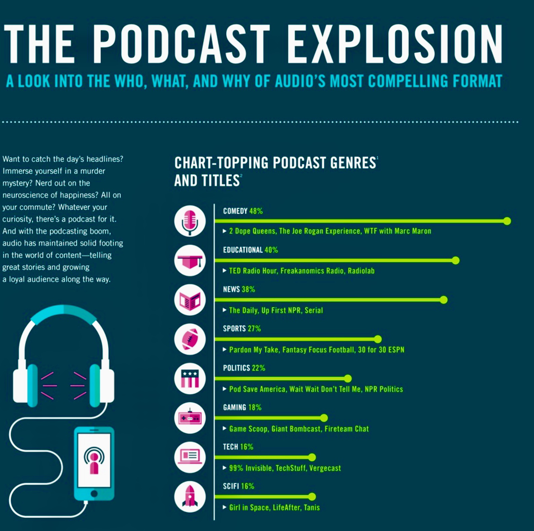

Slide 14


Slide 15



Slide 16
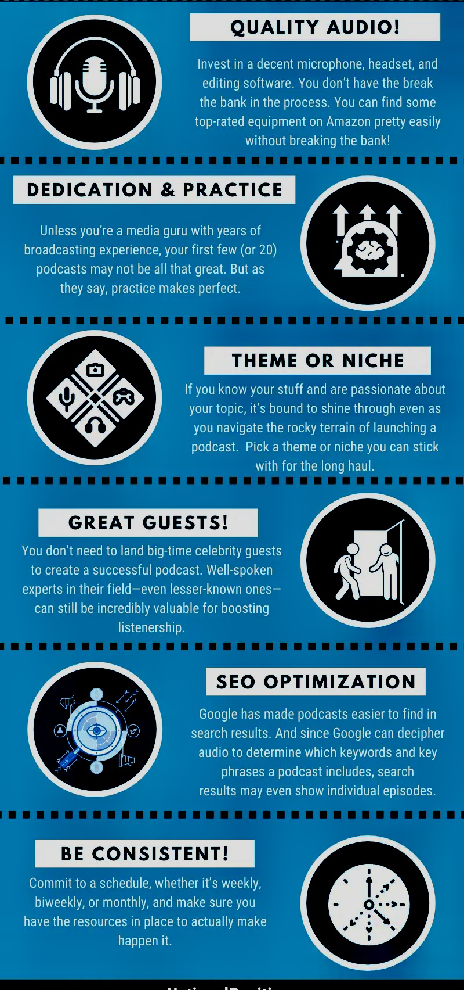
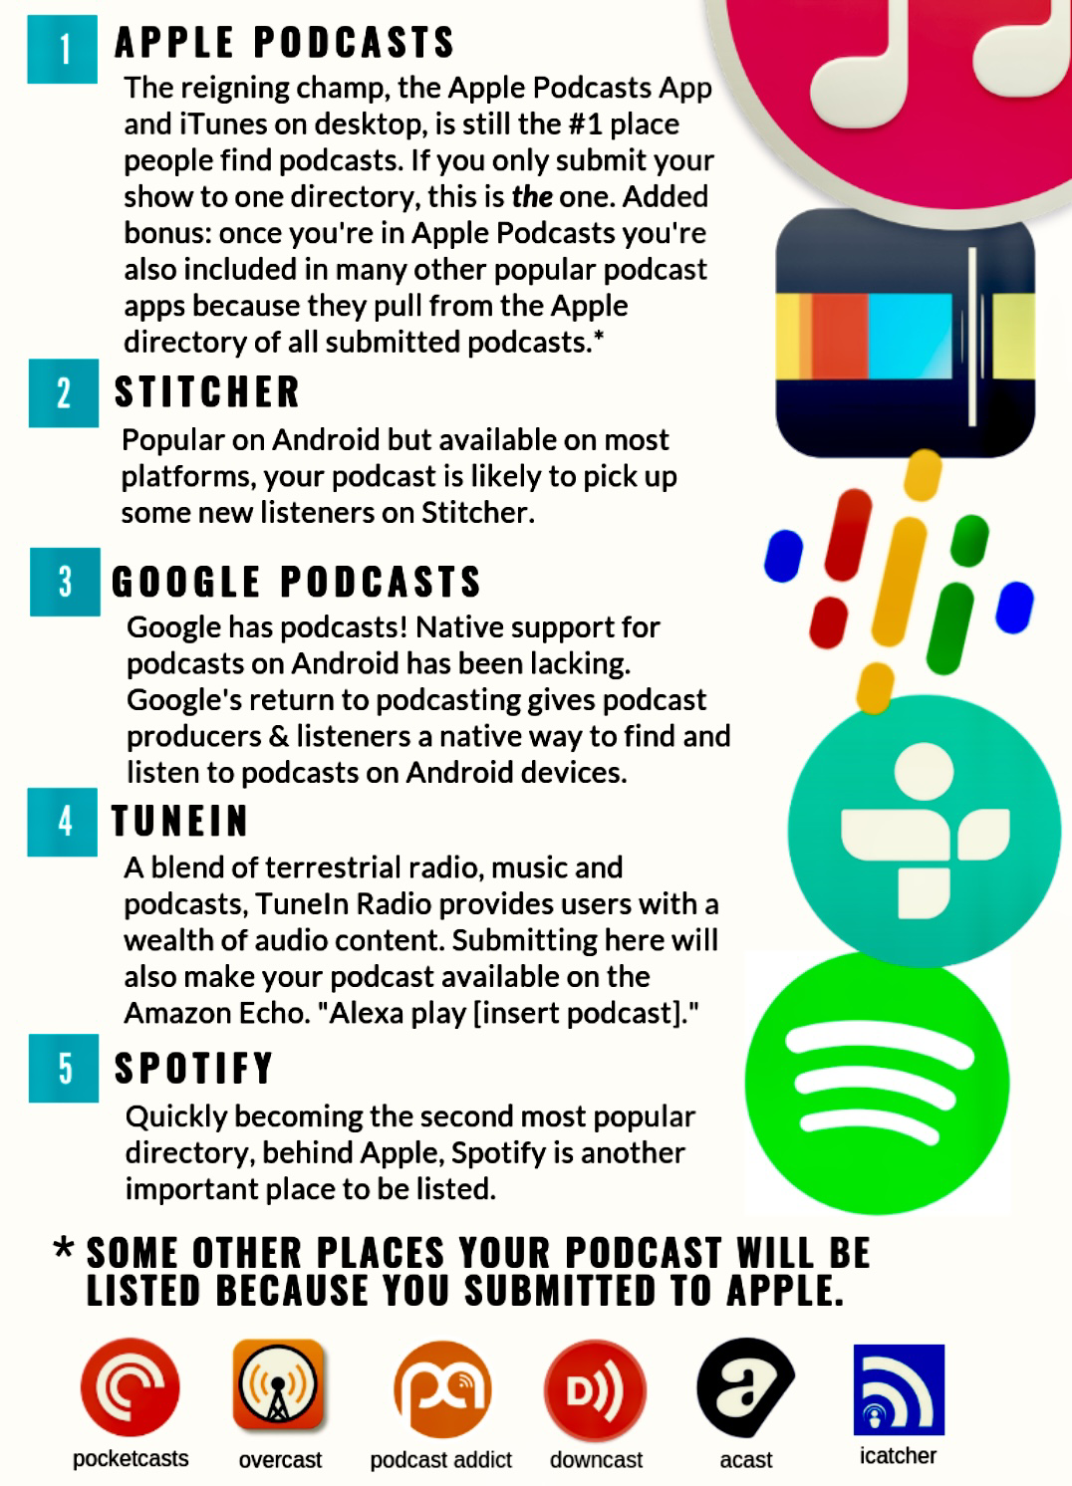

Slide 17
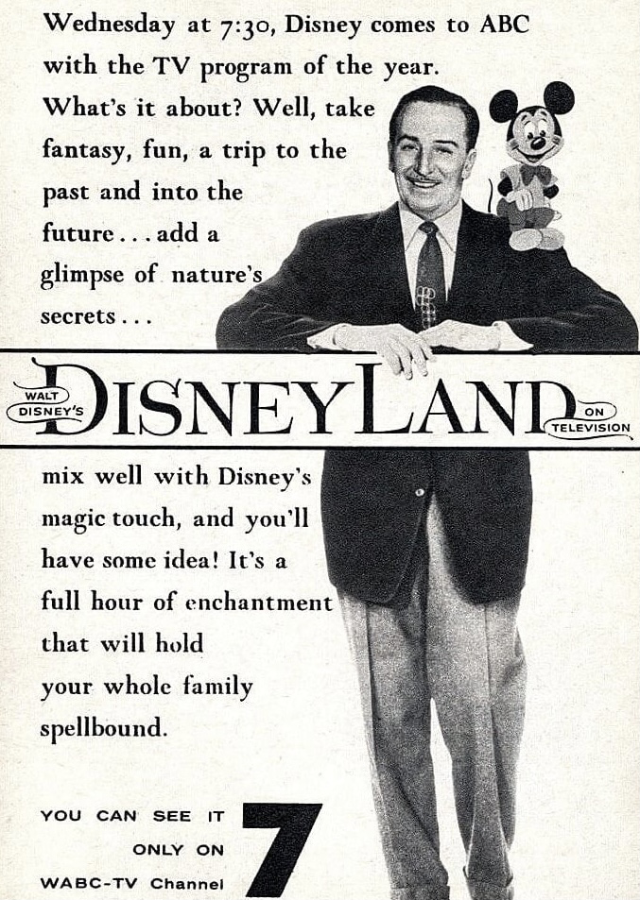


Slide 18

The Most important phrase for podcast hosts and guests to remember:

Slide 19

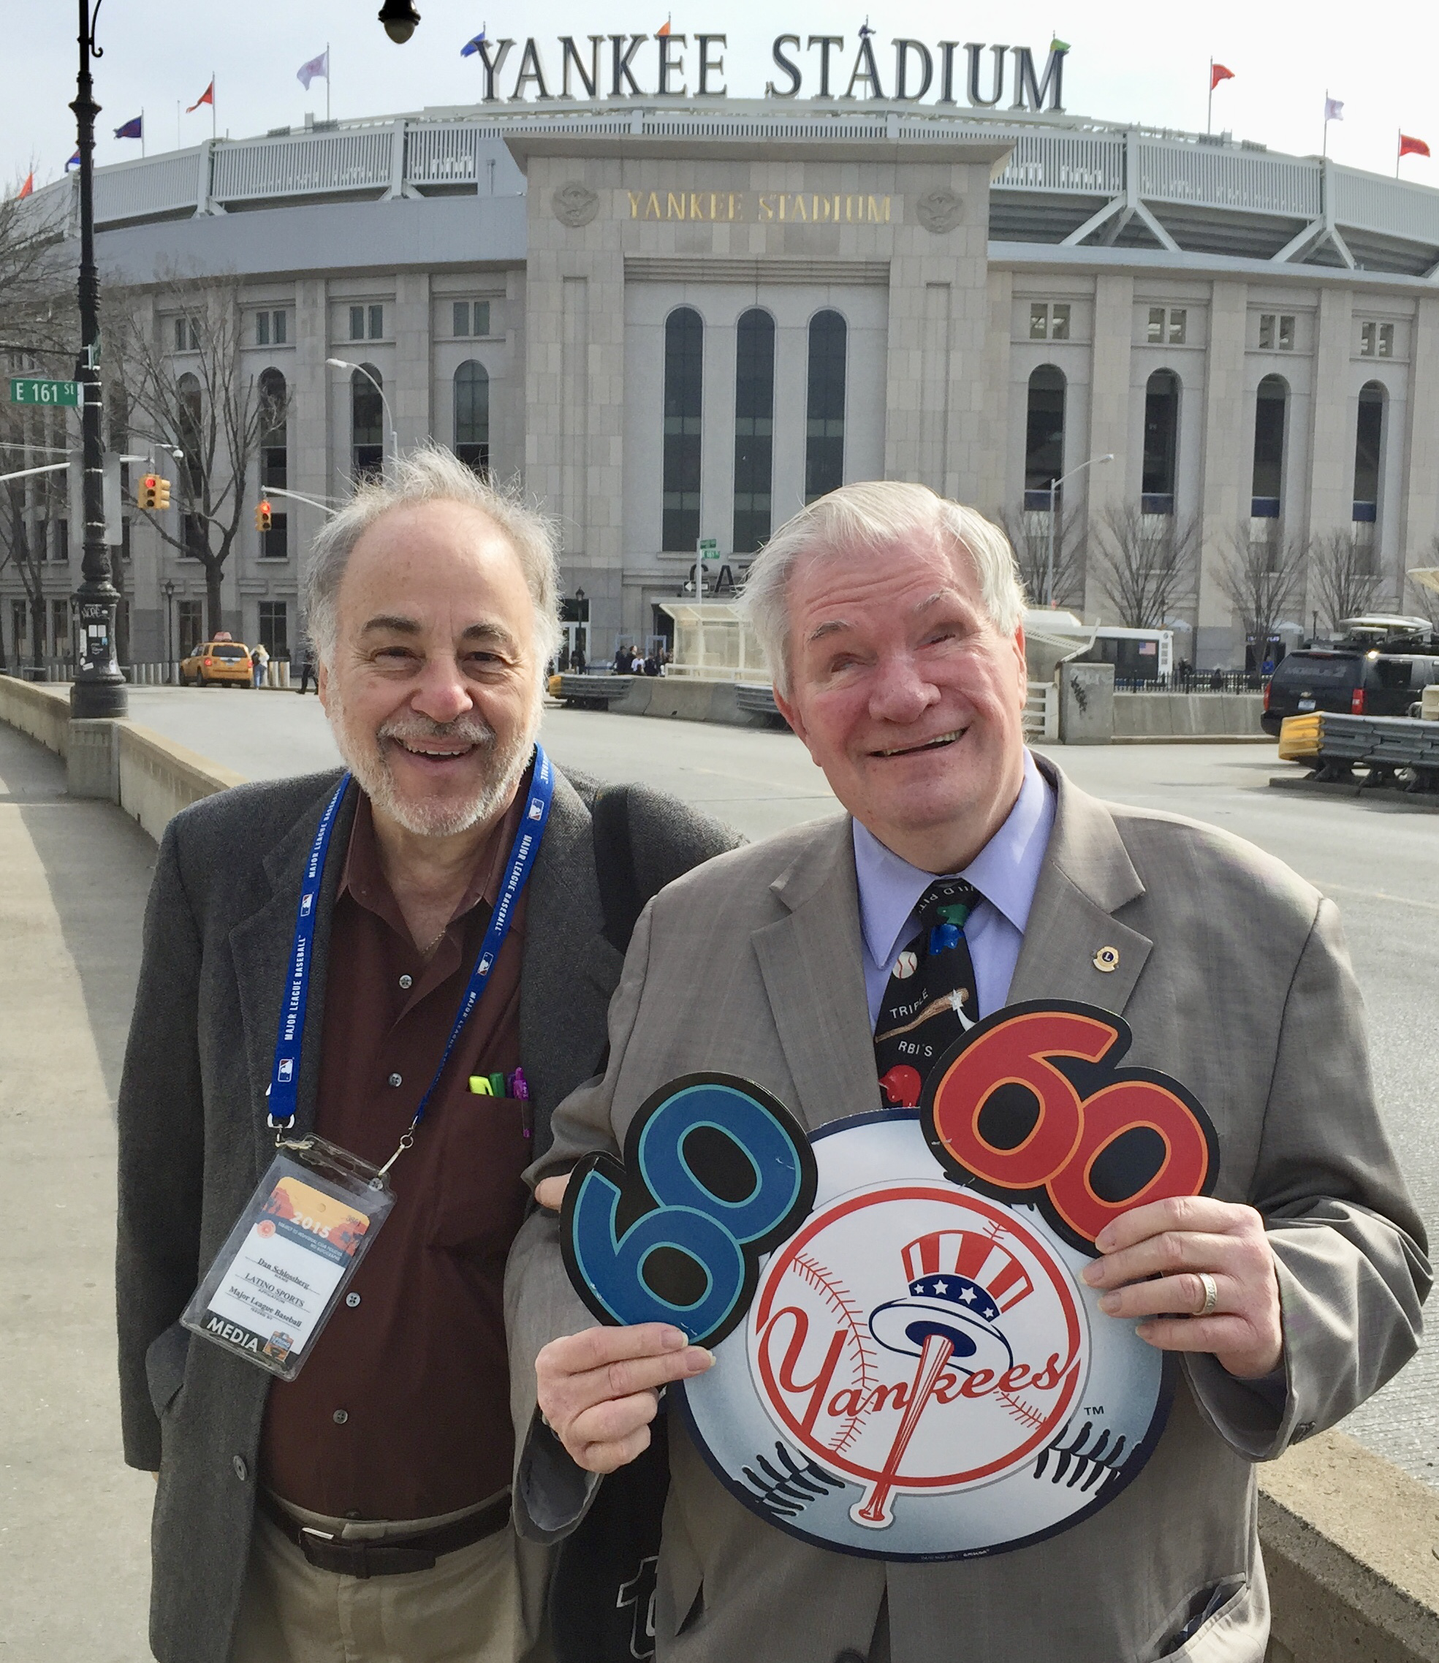
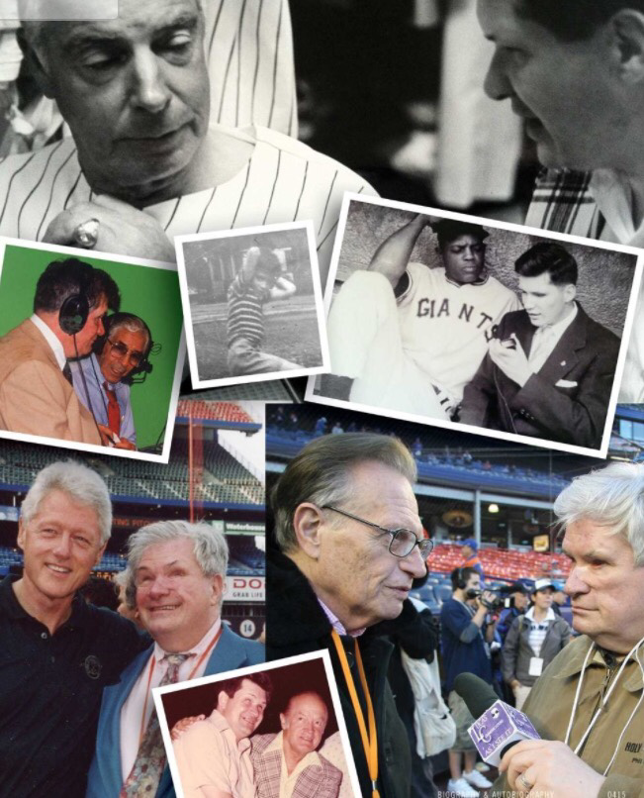

Slide 20
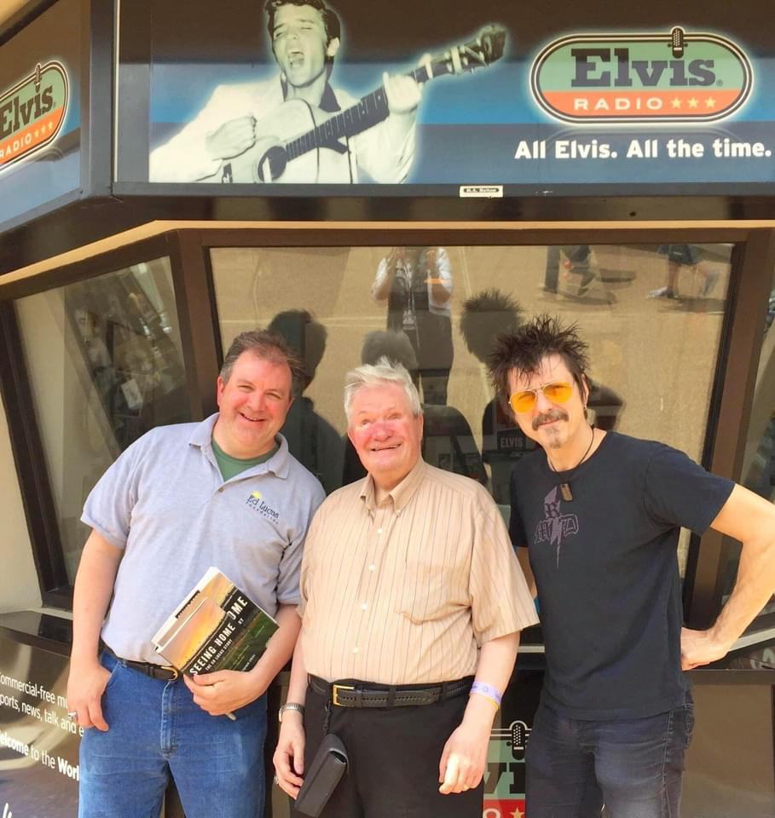
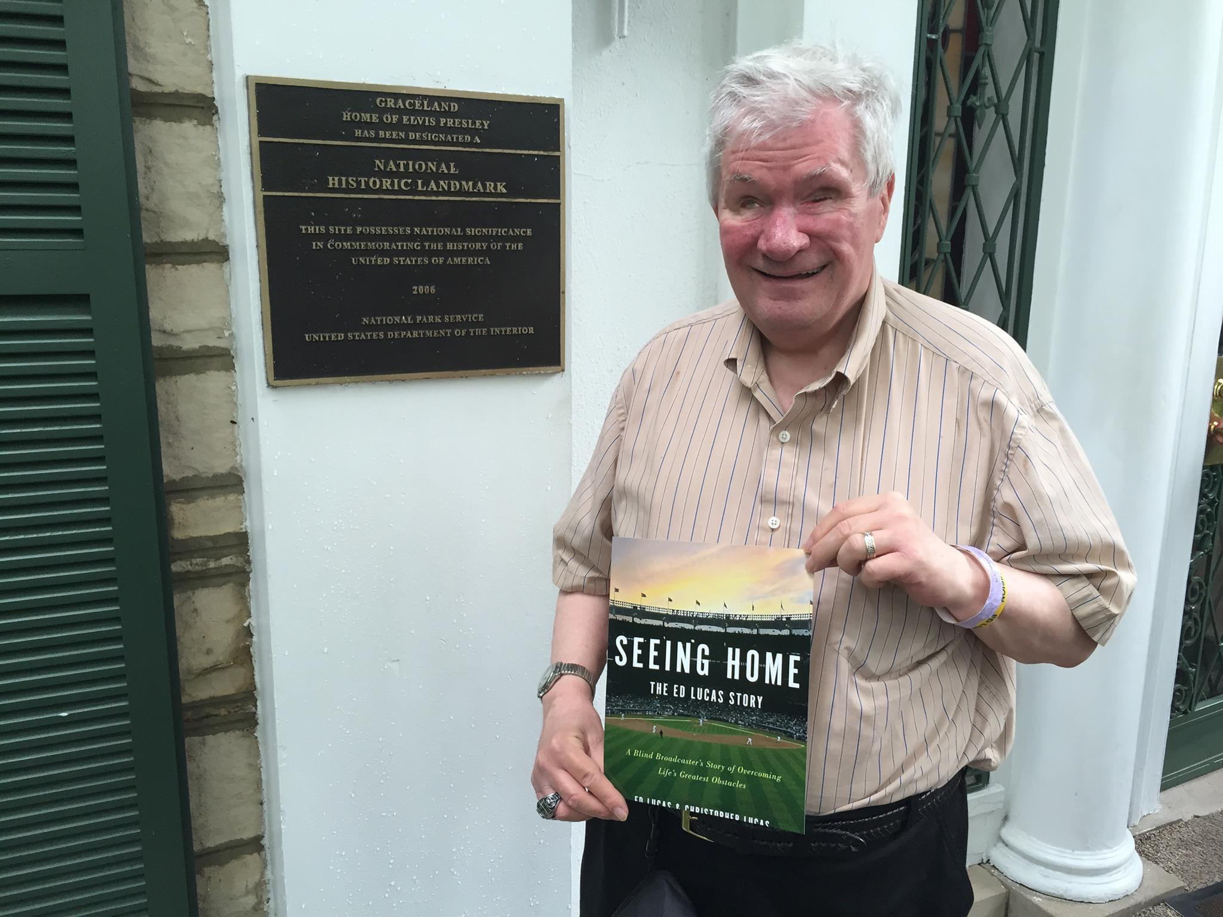

Slide 21



Slide 22


Slide 23
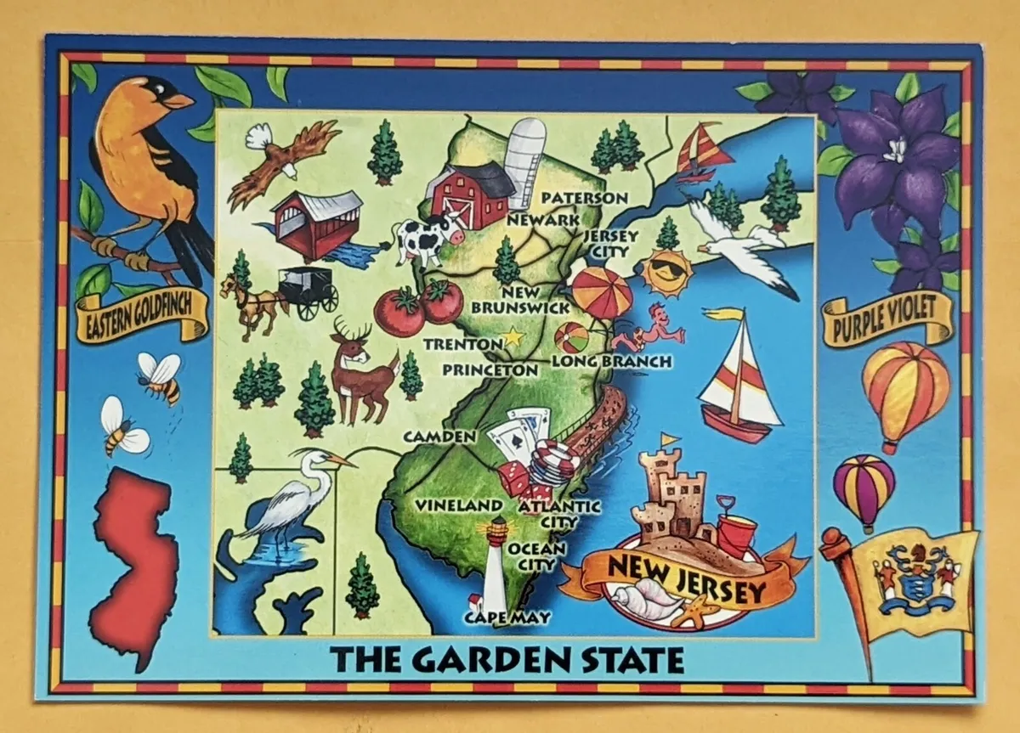

Slide 24
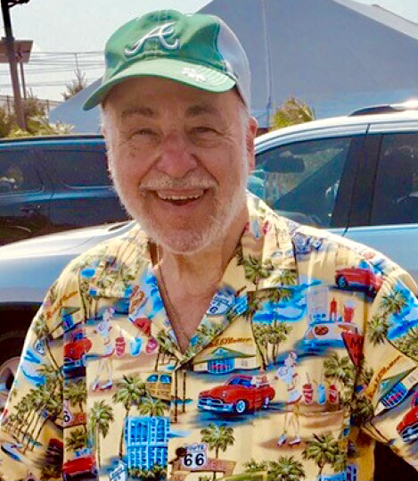
If you are interested in being a guest on travel itch radio with Dan schlossberg please contact dan by email at: ballauthor@gmail.com

